Slide 1
CS 2212
Introduction to Software Engineering
Chapter 14 Pattern Based Design

Slide 2
Copyright Notice This Presentation and Its Associated Video Contain Copyright Material. This Presentation and Its Associated Video Are Provided for Teaching Purposes of CS2212 and Should Not Be Posted In Any External Site, Or Shared with. This Presentation and Its Associated Video Are Provided For Instructional Personal Use Only, and Only For The Purposes of the CS2212 Course.

Slide 3
Part 40
Structural Design Patterns
Knowledge is your operating system.
― Md Parvej Ansari.
Notes:
This lesson introduces the basic steps in a software engineering project at a high level.
In practice, steps often overlap.

Slide 4
Learning Objectives in this Part
To understand some of the foundational Creational Patterns

Slide 5
Classification of GoF Design Pattern
Creational | Structural | Behavioral
Singleton Factory Method Abstract Factory Builder Prototype | Adapter Bridge Composite Decorator Flyweight Facade Proxy | Interpreter Template Method Chain of Responsibility Command Iterator Mediator Memento Observer State Strategy Visitor
© E. Gamma, R. Helm, R. Johnson, J. Vlissides and Addison-Wesley

Slide 6
Adapter Design Pattern
The Adapter Design Pattern allows for client code to access an object which has different interface from the interface the client code expects the object to have, and all these without the need to change neither the object or the client code.
This design pattern is useful when we want:
1) To replace a class A with another one (say B) which has a different interface than class A, without changing the clients using the class A
2) To implement a class that interacts with other classes for which we do not know yet the final design of their interfaces (e.g. during the system design phase)

Slide 7
Structural Elements of the Adapter Design Pattern
Participating classes. The classes that implement the pattern are:
The class Target
The class that defines the interface which the client code expects. It is the interface the client code invokes.
The class Adaptee
The class which defines the interface which is actually used
The class Adapter
The class that adapts the interace of the class Adaptee to the interface of the class Target
The class Client
The class that contains the client code that uses the Target class

Slide 8
Adapter – Construction / Use
We first design and implement the class Target that defines the methods which implement the interface expected by the client code
Then, we design and implement the class Adapter which defines the interface that is required to access the interface of the class Adaptee. The class Adapter inherits from the class Target and provides a transformation of the calls initiated from the client code to calls that are compatible with the interface of the class Adaptee. The class Adapter overrides the methods of the class Target and implements them in a way that are compatible with the Adaptee inerface.
This design pattern is very useful as it allows for the client code to remain the same even though the classes that are actually used may change. This pattern is particularly useful during the design of very large systems where the interfaces of several modules may need to change.

Slide 9
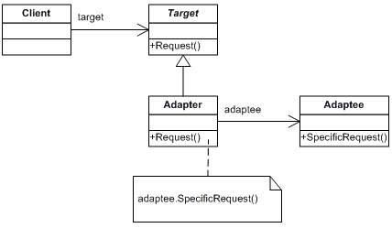
Adapter Design Pattern – Class Diagram

Slide 10
Adapter - Example
// "Target"
public class Target {
public void request() {
System.out.println("Called Target's request()");
}
}
// "Adapter"
public class Adapter extends Target {
private Adaptee adaptee = new Adaptee();
@Override
public void request() {
// Do some other work
// Call the adaptee's specific request
adaptee.specificRequest();
}
}
// "Adaptee"
public class Adaptee {
public void specificRequest() {
System.out.println("Called adaptee's”+
“ specificRequest()");
}
}
// Client code
public class MainApp {
public static void main(String[] args) {
// Create adapter and place a request
Target target = new Adapter();
target.request();
}
}
Output:
Called adaptee’s specificRequest()

Slide 11
Façade Design Pattern
Façade

Slide 12
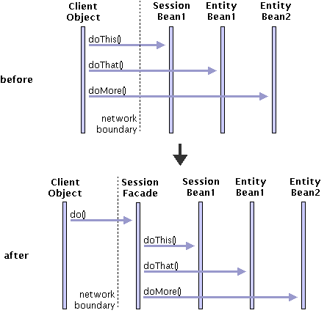
Façade

Slide 13
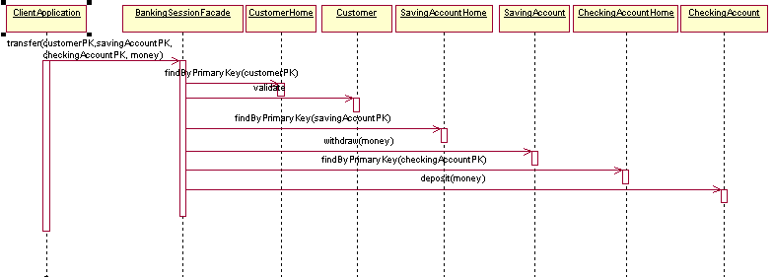
Façade - Example

Slide 14
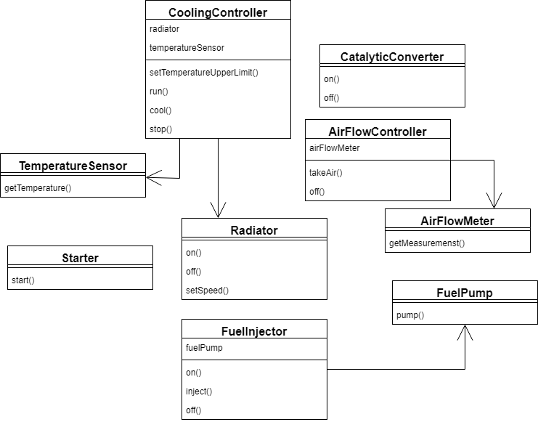
Façade – Another Example

Slide 15
Façade – Another Example(2)
// "Car Engine Facade"
public class CarEngineFacade {
private static int DEFAULT_COOLING_TEMP = 90;
private static int MAX_ALLOWED_TEMP = 50;
private FuelInjector fuelInjector =
new FuelInjector();
private AirFlowController airFlowController = new AirFlowController();
private Starter starter = new Starter();
private CoolingController coolingController = new CoolingController();
private CatalyticConverter catalyticConverter =
new CatalyticConverter();
public void startEngine() {
airFlowController.on();
airFlowController.takeAir();
fuelInjector.on();
fuelInjector.inject();
starter.start();
coolingController
.setTemperatureUpperLimit(
DEFAULT_COOLING_TEMP
);
coolingController.run();
catalyticConverter.on();
}
public void stopEngine() {
fuelInjector.off();
catalyticConverter.off();
coolingController
.cool(MAX_ALLOWED_TEMP);
coolingController.stop();
airFlowController.off();
}
}
https://www.baeldung.com/java-facade-pattern

Slide 16
Proxy Design Pattern
This Design Pattern allows the creation of a "substitute" object that holds a reference for an object, and this "substitute" controls the access to the object for which it acts as a "substitute"
This pattern is useful when a function takes a lot of time to execute, the "substitute" object can send messages about the progress of the function back to the client code
The "substitute" object can also provide complementary functions on behalf of the object for which it acts as a "substitute". For example, the "substitute" object can provide additional functions related to security, access control, RPC,

Slide 17
Structural Elements of the Proxy Design Pattern
The Class Proxy
It keeps a reference to the "real" object and controls access to this "real" object.
It provides an interface that is similar to that of the object acting as a substitute
Controls access to the object and may be responsible for creating and destroying it
It provides complementary functions depending on what type of "substitute" is.
We can define three basic types of substitute objects:
remote proxies are responsible for receiving a call and then encoding it and sending it to the "real" object that is located in another computer system or address space
virtual proxies maintain information about the status of the actual object so that they are able to postpone as much as possible access to the actual object
protection proxies check whether the caller has the appropriate credentials to invoke the actual object and the features it offers
The Class Subject
Specifies a common interface for Proxy and RealSubject class so that the Proxy class can be used where the RealSubject class can be used
The Class RealSubject
It defines the "real" object that will eventually be accessed and will provide the corresponding services

Slide 18
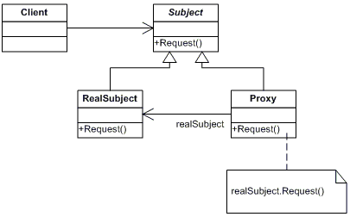
Proxy Design Pattern – Class Diagram

Slide 19
Proxy Design Pattern- Example
// "Subject"
public abstract class Subject {
public abstract void request();
}
// "Real Subject"
public class RealSubject
extends Subject {
@Override
public void request() {
System.out.println("Called”+ “RealSubject.request()");
}
}
// "Proxy"
public class Proxy extends Subject {
private RealSubject realSubject;
@Override
public void request() {
// Use "lazy" initialization
if (realSubject == null)
realSubject = new RealSubject();
realSubject.request();
}
}

Slide 20
Proxy Design Pattern – Client Code
// Client code
public class MainApp {
public static void main(String[] args) {
// Create proxy and request a service
Subject proxy = new Proxy();
proxy.request();
}
}
Output:
Called RealSubject.request()

Slide 21
Your Turn
What is the difference between the Façade pattern and the Adapter pattern? In which situations each one is best to be used for?
What is the difference between the Façade pattern and the Proxy pattern? In which situations each one is best to be used for?
Give two examples of using the Proxy design pattern. Explain the use of the pattern in your examples.
Give two examples for using the Adapter design pattern. Explain the use of the pattern in your examples.
Check-out the content of the following sites:
https://en.wikipedia.org/wiki/Adapter_pattern
https://dzone.com/articles/adapter-design-pattern-in-java
https://en.wikipedia.org/wiki/Facade_pattern
https://en.wikipedia.org/wiki/Proxy_pattern
https://howtodoinjava.com/design-patterns/structural/proxy-design-pattern/

